Slide 1
Session 3
Design Patterns & Object Modeling
HTTP requests and routes
Prepared by
Sandeep Maloth
bri8core@gmail.com

Slide 2
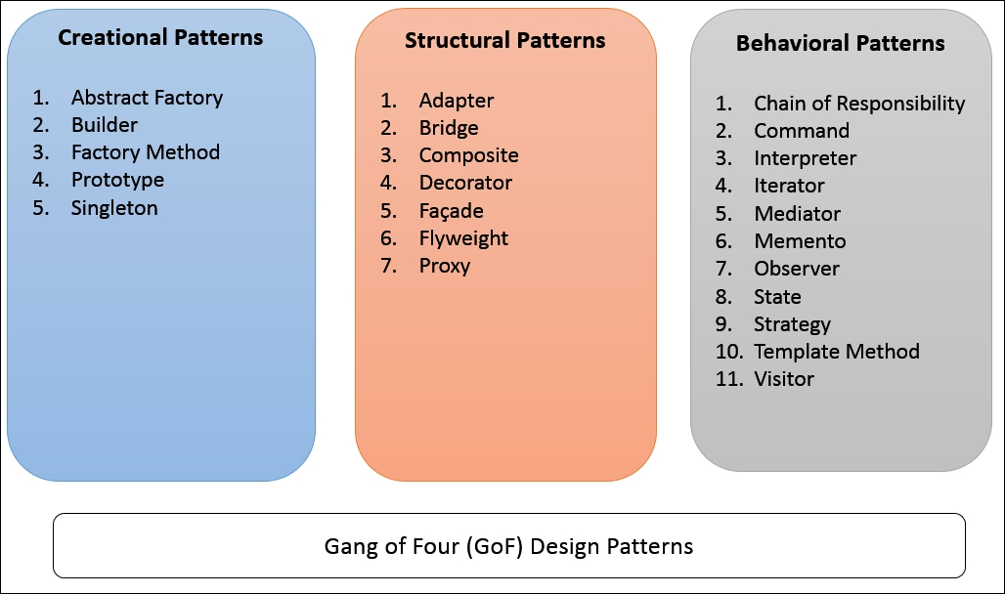
What are Design Patterns?
What are Design Patterns? Design Patterns are reusable solutions to common software design problems.
They provide proven solutions to recurring design challenges. Help in creating more efficient, scalable, and maintainable code.

Slide 3
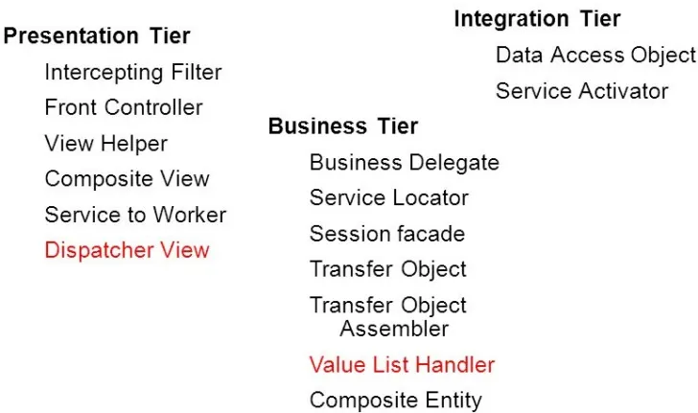
J2ee design patterns

Slide 4
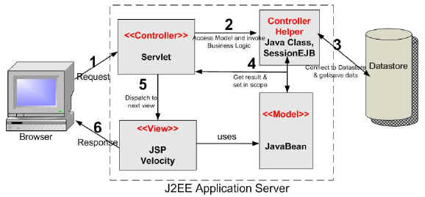
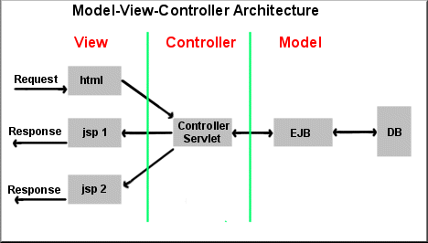
MVC architecture pattern

Slide 5
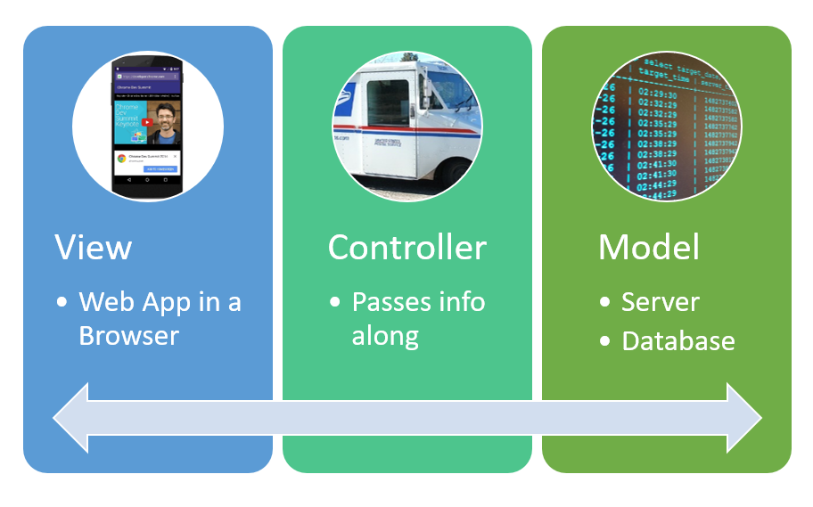
Benefits of Design Patterns
Improve code quality and maintainability.
Encourage best practices in software design.
Foster code reusability and modularity.
Enhance collaboration among developers.

Slide 6
Categories of Design Patterns
Design Patterns: Design patterns categorize common design problems and offer solutions. They include:
Singleton Pattern:
Ensures a class has only one instance and provides a global point of access.
Example: Database connection manager.
Factory Pattern:
Creates objects without specifying the exact class to instantiate.
Example: Creating different types of pizza in a pizza shop.
Observer Pattern:
Defines a one-to-many dependency between objects, so when one object changes state, its dependents are notified.
Example: Weather monitoring system with multiple displays.

Slide 7
Example: Singleton Pattern
Ensures a class has only one instance. Provides a global point of access to that instance. Useful for scenarios where a single instance is required (e.g., database connections).
public class Singleton {
private static Singleton instance;
private Singleton() {
// Private constructor to prevent instantiation from outside
}
public static Singleton getInstance() {
if (instance == null) {
instance = new Singleton();
}
return instance;
}
public void showMessage() {
System.out.println("Singleton instance created.");
}
}
// Usage
public class SingletonDemo {
public static void main(String[] args) {
Singleton singleton = Singleton.getInstance();
singleton.showMessage();
}
}

Slide 8
Factory Method Pattern
interface Shape {
void draw();
}
class Circle implements Shape {
public void draw() {
System.out.println("Drawing a Circle");
}
}
class Rectangle implements Shape {
public void draw() {
System.out.println("Drawing a Rectangle");
}
}
class ShapeFactory {
public Shape getShape(String shapeType) {
if (shapeType == null) {
return null;
}
if (shapeType.equalsIgnoreCase("Circle")) {
return new Circle();
} else if (shapeType.equalsIgnoreCase("Rectangle")) {
return new Rectangle();
}
return null;
}
}
// Usage
public class FactoryPatternDemo {
public static void main(String[] args) {
ShapeFactory shapeFactory = new ShapeFactory();
Shape circle = shapeFactory.getShape("Circle");
circle.draw();
Shape rectangle = shapeFactory.getShape("Rectangle");
rectangle.draw();
}
}
Defines an interface for creating objects. Subclasses decide which class to instantiate. Enables flexibility in object creation
(e.g., different types of products).

Slide 9
Object Modelling

Slide 10
Introduction to Object Modeling
Object Modeling is the process of representing real-world entities as software objects. Objects have attributes (data) and methods (functions). Helps in creating a blueprint for building software systems.
Classes:
Book: Attributes - title, author, ISBN; Methods - checkOut(), returnBook().
Library: Attributes - books, address; Methods - addBook(), removeBook().
Relationships:
Composition: Library has a composition relationship with Book (Library contains Books).
Aggregation: Book has an aggregation relationship with Author (Book is composed of Author).

Slide 11
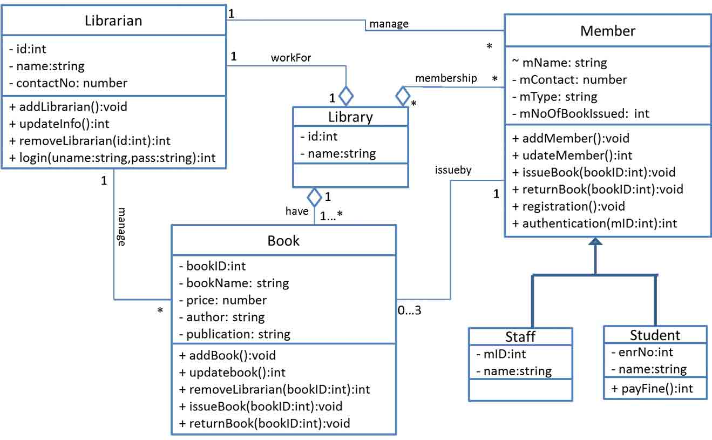
Class, Object, and Attributes
Class: Blueprint/template for creating objects. Object: Instance of a class. Attributes: Data members that define the object's properties.
Library management system

Slide 12
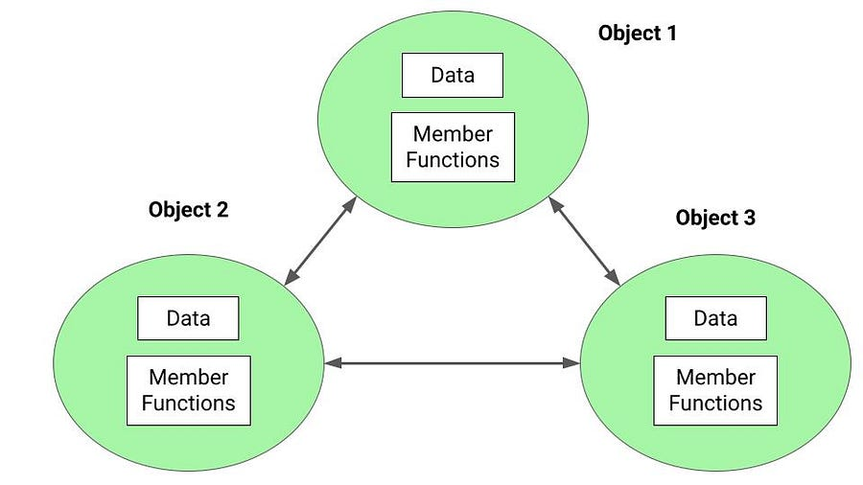
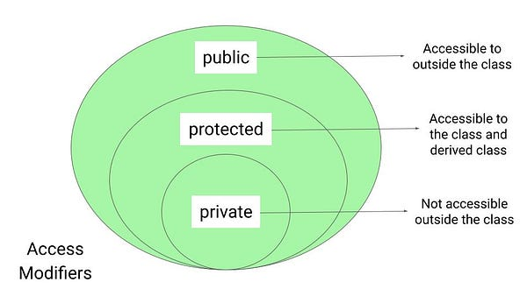
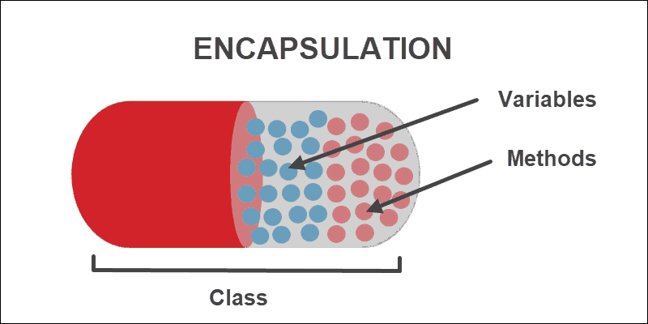
Methods and Encapsulation
Methods: Functions within a class that define its behavior. Encapsulation: Bundling data (attributes) and methods together in a class. Access modifiers (public, private, protected) control access to attributes and methods.

Slide 13
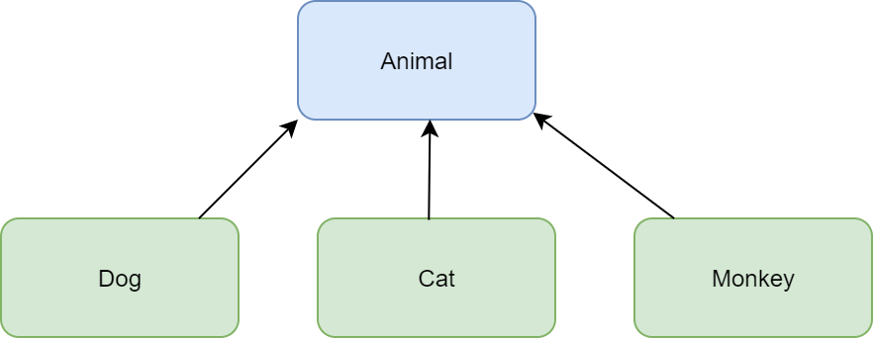
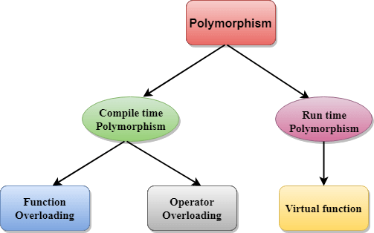
Inheritance and Polymorphism
Inheritance: Hierarchical relationship between classes. Subclasses inherit attributes and methods from parent classes. Polymorphism: Objects of different classes can be treated as objects of a common superclass.

Slide 14
HTTP Request and REST API

Slide 15
Introduction to HTTP Requests
HTTP (Hypertext Transfer Protocol) is the foundation of data communication on the web. Clients (browsers, apps) send requests to servers to retrieve resources.
HTTP Requests: HTTP requests are methods a client uses to request resources from a server. Common HTTP methods include:
GET:
Requests data from a specified resource.
Example: Retrieving a blog post.
POST:
Sends data to be processed to a specified resource.
Example: Submitting a form.
PUT:
Updates a resource or creates it if it doesn't exist.
Example: Updating a user's profile.
DELETE:
Deletes a specified resource.
Example: Deleting a comment.

Slide 16
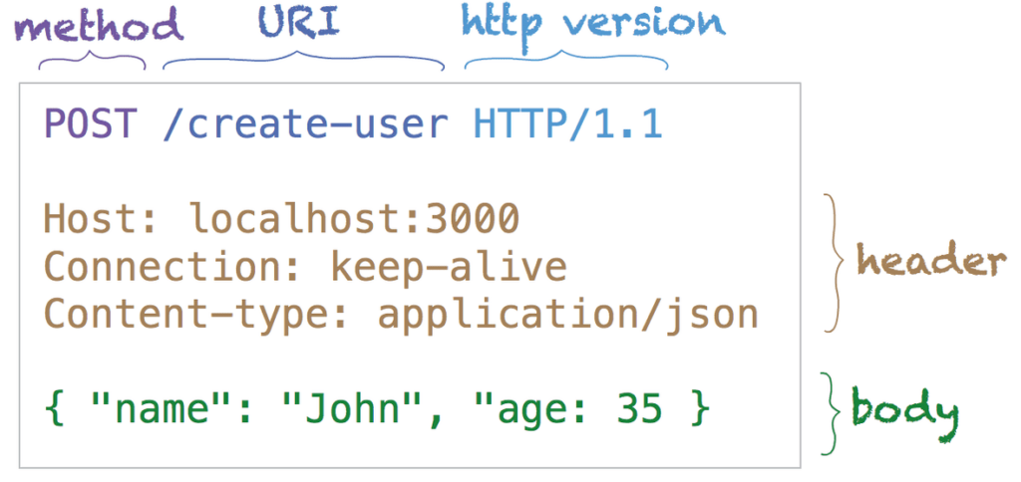
Anatomy of an HTTP Request
Request Line: Method, URL, and HTTP version. Headers: Additional information about the request. Body (for some methods): Data to send to the server.

Slide 17
Example: Sending a GET Request
GET requests retrieve data from the server. Request: GET /api/posts HTTP/1.1 Headers: Accept: application/json Example: Sending a GET Request
POST requests submit data to the server. Request: POST /api/posts HTTP/1.1 Headers: Content-Type: application/json Body: {"title": "New Post", "content": "Hello, world!"}
Representational state transfer (REST) is a software architectural style that defines a set of constraints to be used for creating Web services.

Slide 18
Anatomy of REST:
Endpoint: it is the URL where the REST Server is listening.
Method: REST implements multiple 'methods' for different types of request, the following are most popular: - GET: Get resource from the server. - POST: Create resource to the server. - PATCH or PUT: Update existing resource on the server. - DELETE: Delete existing resource from the server.
Headers: The additional details provided for communication between client and server (remember, REST is stateless). Some of the common headers are: Request: - host: the IP of client (or from where request originated) - accept-language: language understandable by the client - user-agent: data about client, operating system and vendor Response: - status: the status of request or HTTP code. - content-type: type of resource sent by server. - set-cookie: sets cookies by server
Data: (also called body or message) contains info you want to send to the server.
More details : https://www.freecodecamp.org/news/rest-api-tutorial-rest-client-rest-service-and-api-calls-explained-with-code-examples/

Slide 19
Introduction to Routes
Routes define the paths to different parts of a web application. A route maps to a specific handler function or resource.
Often used in RESTful APIs and web frameworks.
Example: Blog Website
Route Mapping:
GET /articles: Display a list of articles.
GET /articles/:id: Display a specific article.
POST /articles: Create a new article.
PUT /articles/:id: Update an existing article.
DELETE /articles/:id: Delete an article.
Implementation:
When a user navigates to /articles, the server responds by fetching and displaying a list of articles.
When a user submits a form to create an article, the server receives the data and adds a new article to the database.

Slide 20
Design Patterns & Object Modeling:
1: Reusable solutions to common problems in software design.
- Explain the importance of design patterns for creating modular, maintainable, and scalable software.
2: Types of Design Patterns
- Mention three main categories: Creational, Structural, and Behavioral design patterns.
- Briefly explain each category's purpose and examples.
3: Singleton Pattern
- Describe the Singleton pattern, which ensures a class has only one instance.
- Explain its implementation and use cases (e.g., database connections, configuration).
4: Factory Pattern
- Introduce the Factory pattern, responsible for creating objects without specifying the exact class.
- Show how it simplifies object creation, encapsulating complex logic.
5: Observer Pattern
- Define the Observer pattern, where an object maintains a list of its dependents (observers) and notifies them of changes.
- Illustrate how it promotes loose coupling and real-time updates in applications.
6: MVC Pattern
- Explain the Model-View-Controller pattern, which separates an application into three interconnected components.
- Discuss how MVC enhances maintainability and scalability.
7: Applying Design Patterns
- Highlight the importance of choosing the right pattern for the context.
- Emphasize that design patterns are tools, not solutions for all scenarios.
8: Object Modeling Basics
- Introduce object modeling as the process of representing real-world entities in software.
- Discuss attributes and behaviors, which map to properties and methods in programming.
9: UML Class Diagrams
- Briefly describe UML (Unified Modeling Language) and its use in visualizing class relationships.
- Show a basic UML class diagram and its components.
10: Aggregation and Composition
- Differentiate between aggregation (whole-part relationship) and composition (stronger relationship).
- Provide examples to illustrate each concept.
11: Inheritance vs. Composition
- Compare inheritance (IS-A relationship) and composition (HAS-A relationship).
- Explain when to choose one over the other based on code reusability and maintainability.

Slide 21
HTTP Requests & Routes:
1: Introduction
- HTTP (Hypertext Transfer Protocol) as the foundation of communication on the web.
- Explain how HTTP requests and routes enable interaction between clients and servers.
2: HTTP Methods
- List common HTTP methods: GET, POST, PUT, DELETE.
- Explain each method's purpose (retrieve, create, update, delete).
3: Anatomy of an HTTP Request
- Break down an HTTP request: Request line, headers, and body.
- Highlight key headers like Content-Type, Accept, and Authorization.
4: RESTful API Design
- Define REST (Representational State Transfer) and its principles for creating APIs.
- Discuss resources, URLs, and CRUD (Create, Read, Update, Delete) operations.
5: Routes and URL Structure
- Explain routes as mappings between URLs and application logic.
- Discuss URL parameters and query parameters for dynamic and filtered content.
6: Route Handling in Web Applications
- Describe how routes manage application flow and user interaction.
- Mention routing systems in frameworks like Express.js (Node.js) and Django (Python).
7: HTTP Status Codes
- Present common HTTP status codes (200 OK, 404 Not Found, 500 Internal Server Error).
- Explain how status codes indicate the outcome of a request.
8: RESTful API Example
- Walk through a simple example of building a RESTful API (e.g., CRUD operations for books).
- Illustrate the use of HTTP methods and routes.

Slide 22
References:
Gang of four design patterns : https://springframework.guru/gang-of-four-design-patterns/
REST API : https://www.freecodecamp.org/news/rest-api-tutorial-rest-client-rest-service-and-api-calls-explained-with-code-examples/

